Slide 1



Analysis of Big Data on Android using Facebook Graph API
Tanvir Sourov
Co-Founder & CEO
Socian Ltd & Technolive
fb.com/sourov011
TECHNOLIVE

Slide 2
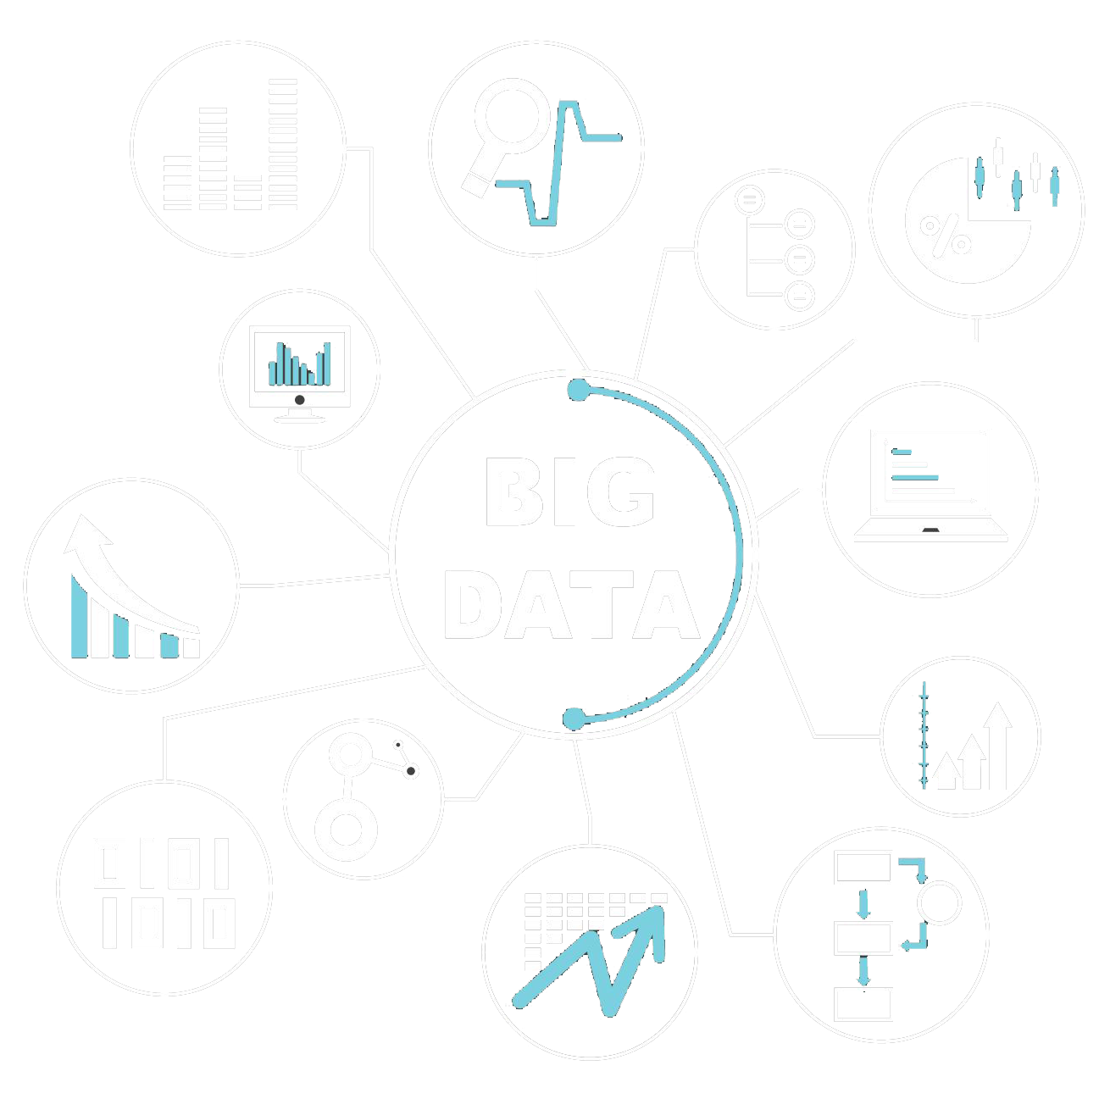
Big Data
Big data is a term for data sets that are so large or complex that traditional data processing application software is inadequate to deal with them. Challenges include capture, storage, analysis, data curation, search, sharing, transfer, visualization, querying, updating and information privacy.

Slide 3
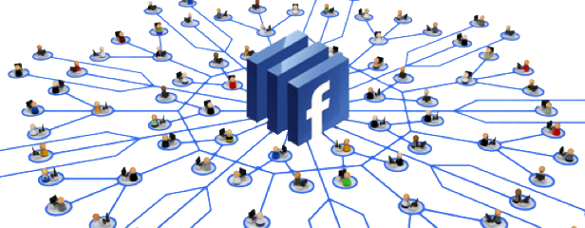
Facebook Graph API
The primary way for apps to read and write to the Facebook social graph. Directly access data from Facebook Platform and also send data on behalf of Users or Pages.
Current Version: 2.9

Slide 4
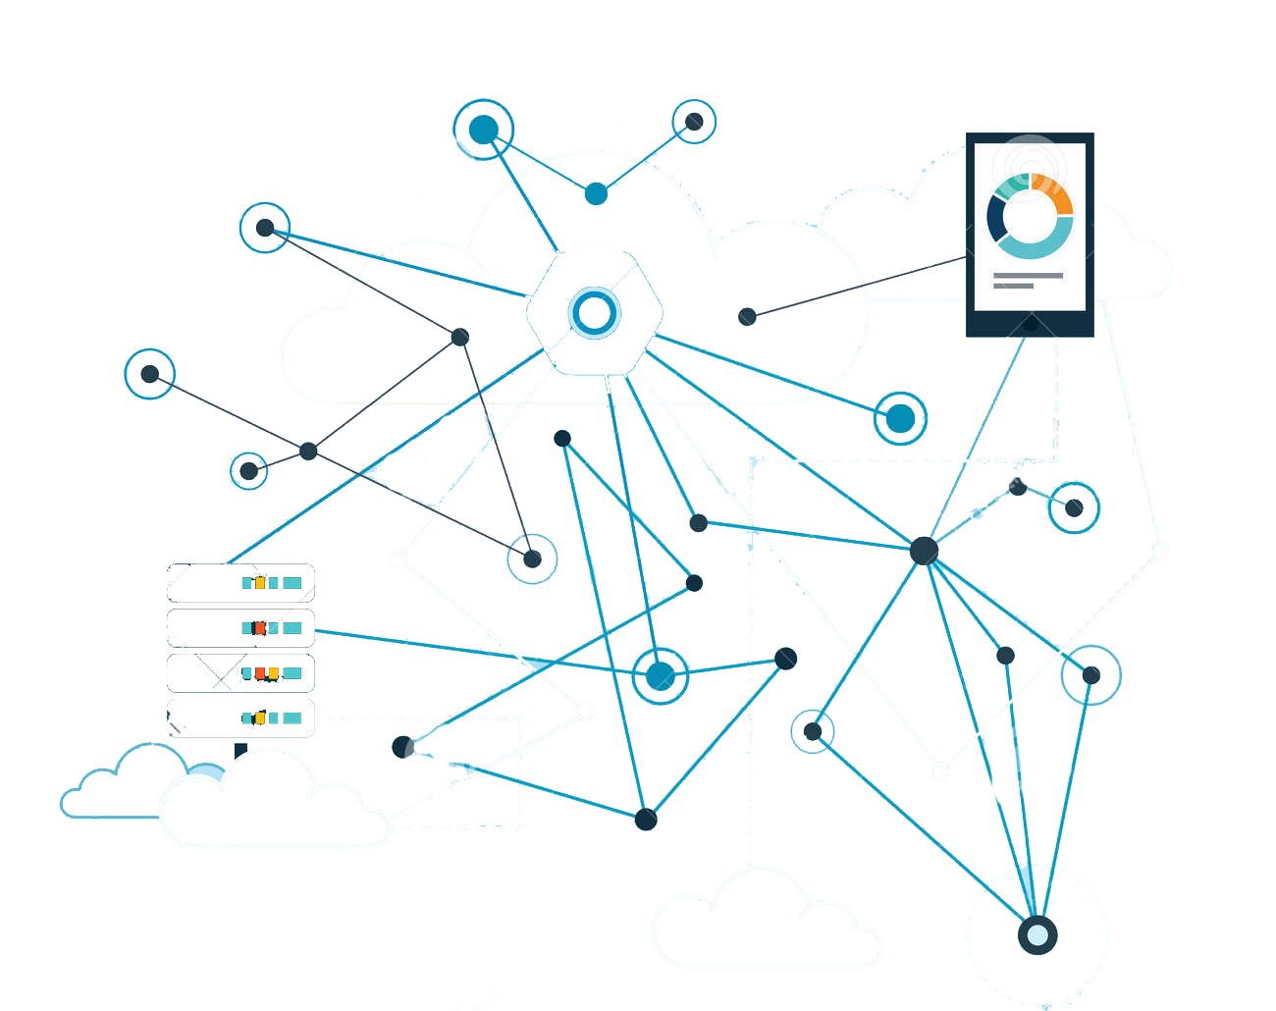
Big Data on Android using FB Graph API
Graph API fetches data from FB Data Storage Based on the query, data is optimized Data comes to the Android Phone Goes through different analyzing
Data is displayed with Infographs

Slide 5

https://developers.facebook.com/tools/explorer
API
https://graph.facebook.com
Personal Feed
https://graph.facebook.com/[user_id]/feed&hidden=true
Access Token
Give Permission to Access Data

Slide 6
Permissions
public_profile
user_posts
user_friends
user_birthday
user_events
user_location
user_website
user_videos
user_photos
user_likes
To know more, please visit: https://developers.facebook.com/docs/facebook-login/permissions

Slide 7
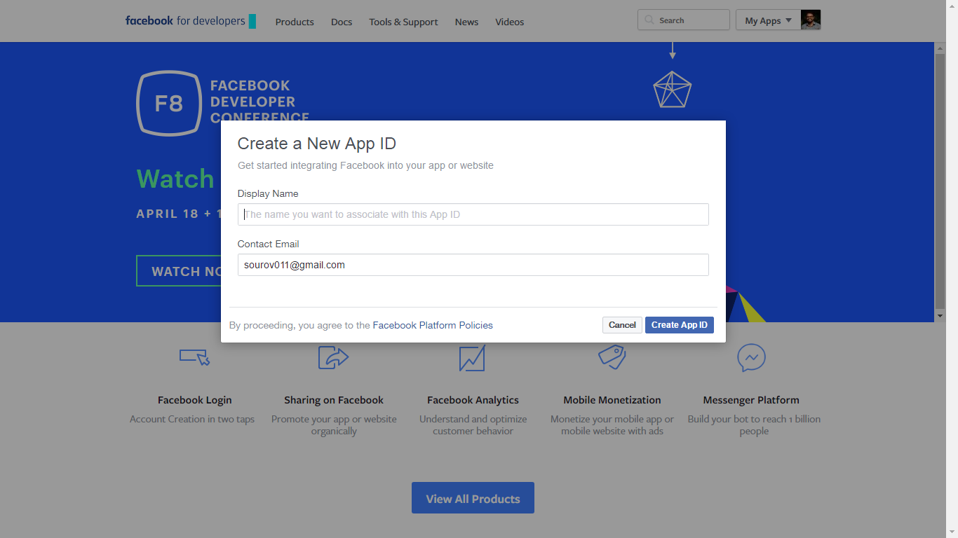

Slide 8
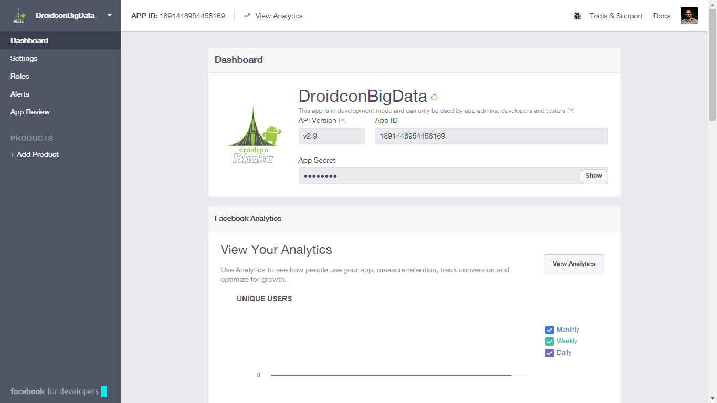

Slide 9
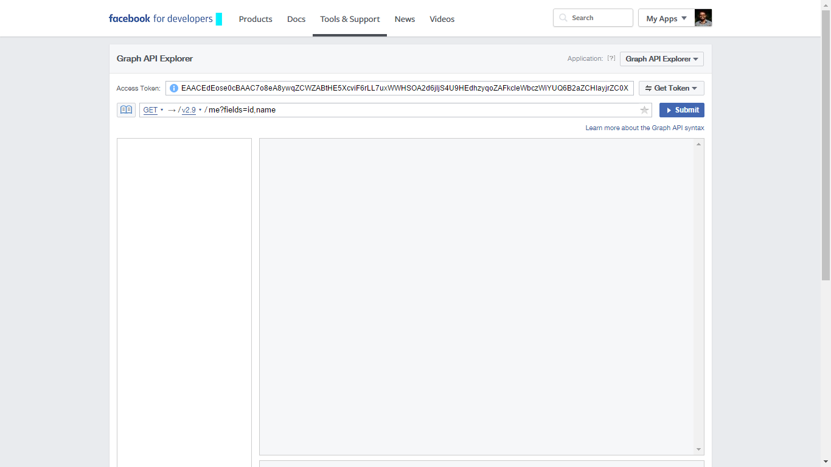

Slide 10
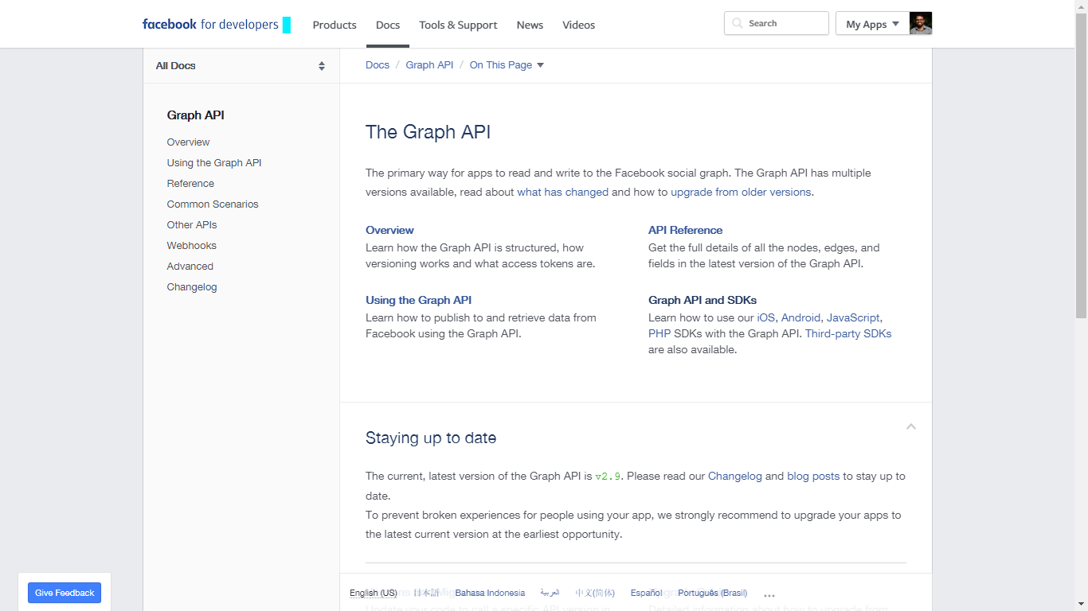

Slide 11
LET’S SEE SOME CODE

Slide 12


THANK YOU
ECHNOLIVE
Think Socially, Thrive Globally
Live with technology
www.socian.xyz www.technolive.co
contact@socian.xyz contact@technolive.co
+8801726867984

